Slide 1
CONCEPTS OF ENGINEERING DESIGN
PROJECT TEAM 1

Slide 2
VOICE SENSOR FOR ELECTRONIC GADGETS
Team 1
112101010 CHAPATI ANUSHA
122101006 BURAGA AAKANKSHA
112101008 CHALLA PAVAN KUMAR REDDY
122101010 DASARI SATYA DURGA CHARISHMA
112101005 BALAGA SANTHOSHI KUMARI
112101006 BEJJANKI KARTHIKEYA
112101001 ABHINAY RATHORE

Slide 3
VOICE SENSOR FOR ELECTRONIC GADGETS

Slide 4
VOICE SENSOR FOR ELECTRONIC GADGETS
Our Motive is to open a Door latch with a voice command, simultaneously glow the LED lights accordingly.

Slide 5
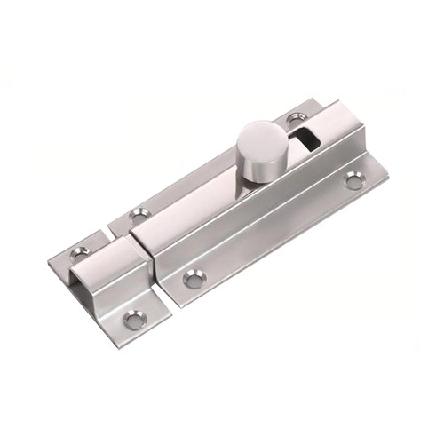

VOICE SENSOR FOR ELECTRONIC GADGETS
Our Motive is to open a Door latch with a voice command, simultaneously glow the LED lights accordingly

Slide 6
VOICE SENSOR FOR ELECTRONIC GADGETS
COMPONENTS USED

Slide 7
VOICE SENSOR FOR ELECTRONIC GADGETS
COMPONENTS USED
Arduino
Stepper Motor
Stepper Motor Driver L298N
Bluetooth Module
Door Latch
Other Miscellaneous components like bread board, jumper wires, etc.

Slide 8

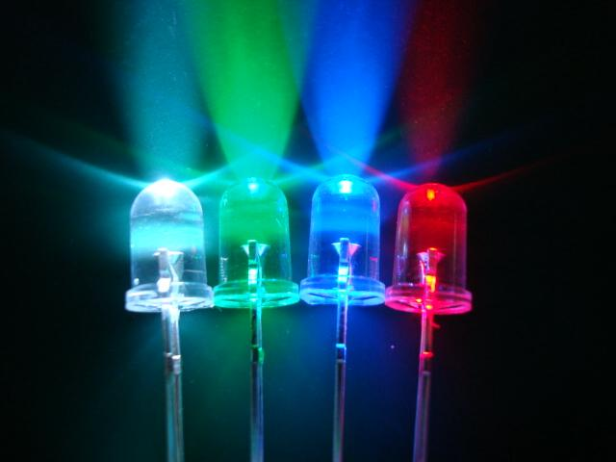
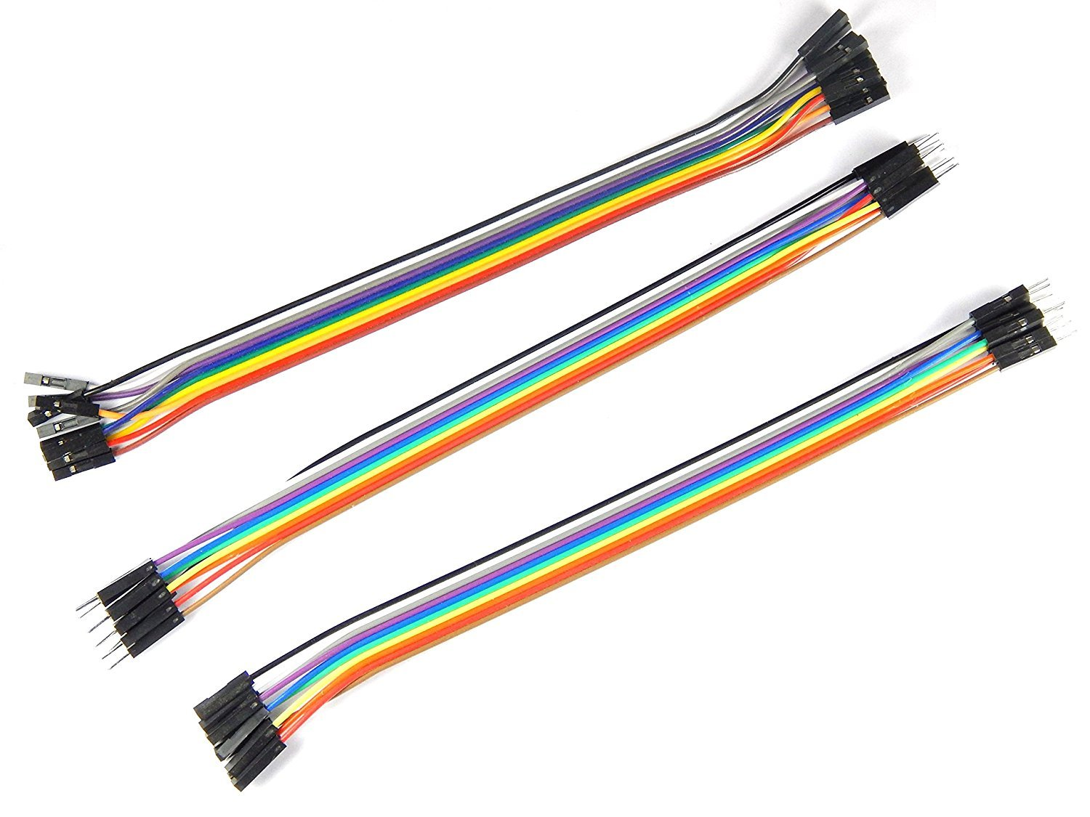
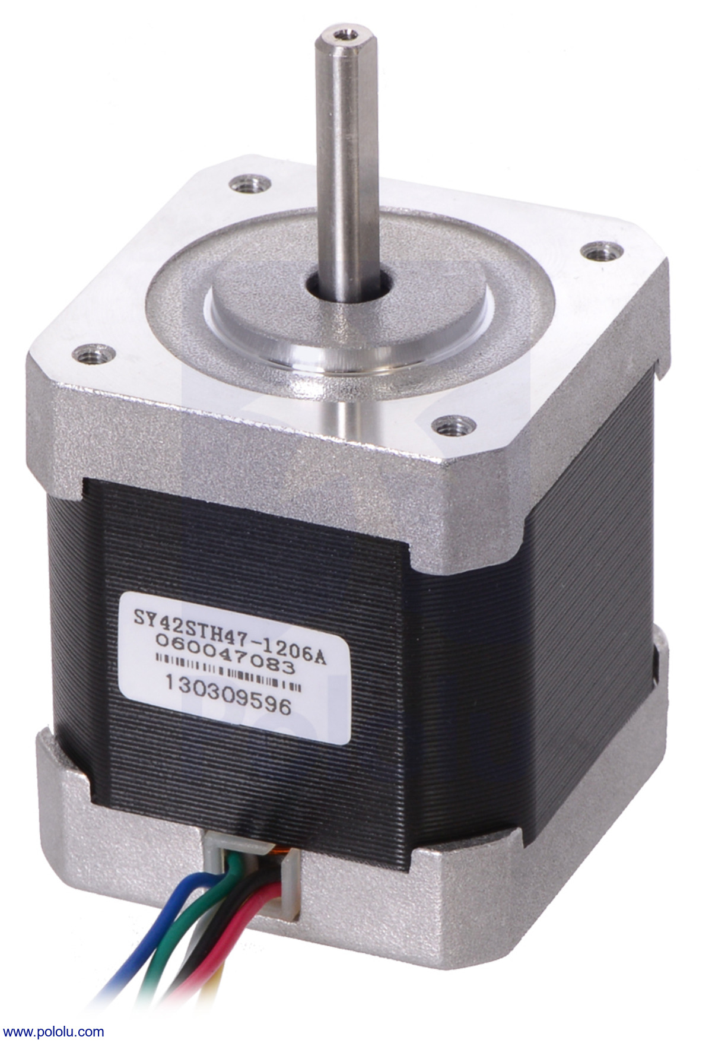
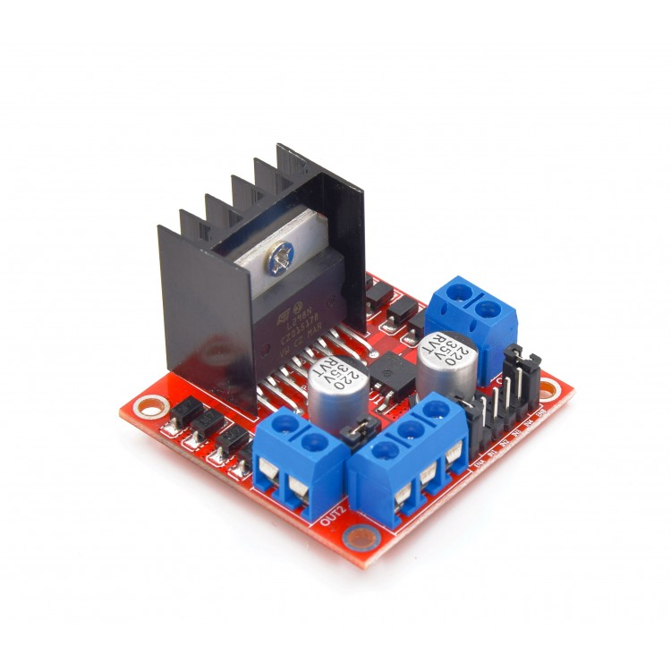
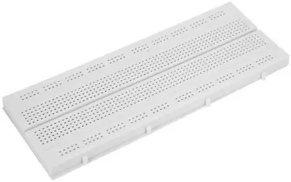
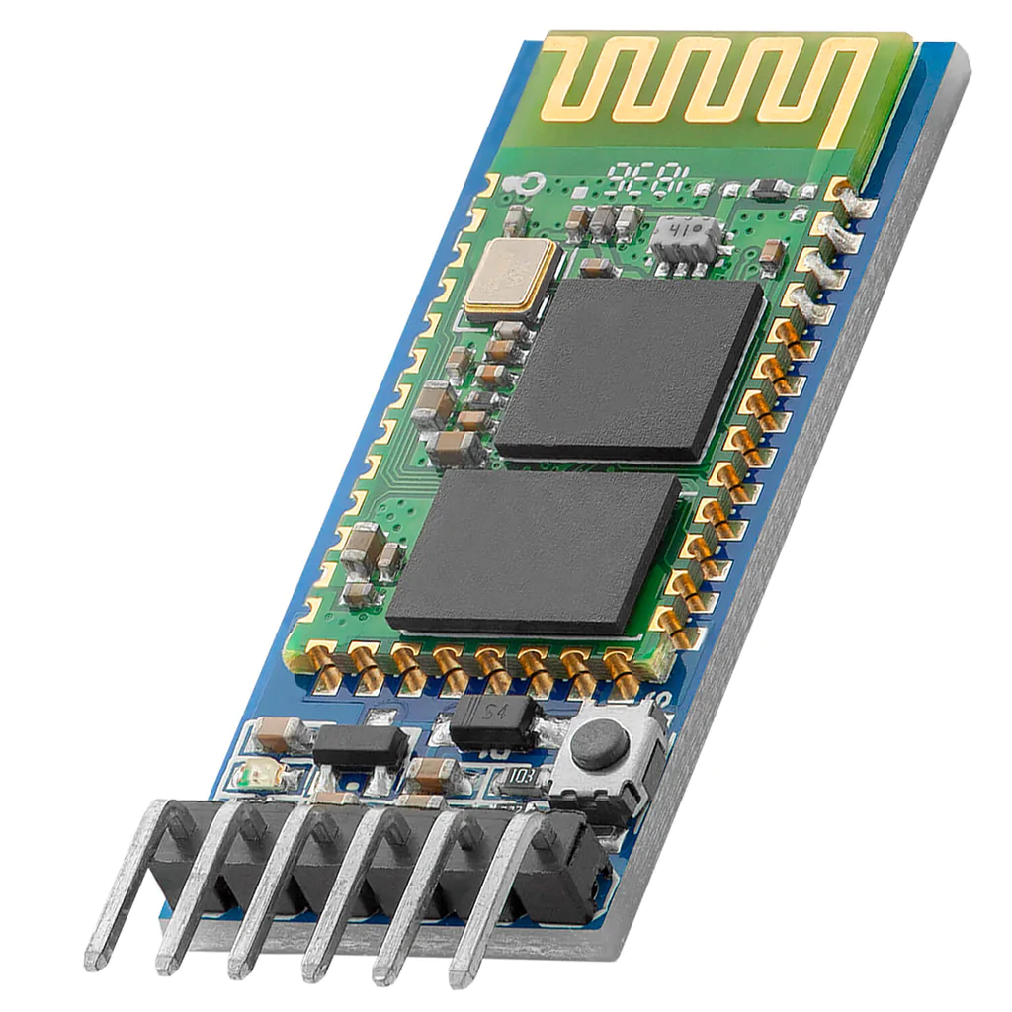
VOICE SENSOR FOR ELECTRONIC GADGETS
ARDUINO UNO
LED LIGHTS
JUMPER WIRES
STEPPER MOTOR
L298N MOTOR DRIVER
BREAD BOARD
BLUETOOTH MODULE

Slide 9

VOICE SENSOR FOR ELECTRONIC GADGETS
BLUETOOTH MODULE HC-05
A SPP(serial port protocol) module used for transparent wireless serial connection setup.

Slide 10
VOICE SENSOR FOR ELECTRONIC GADGETS
ARDUINO
This is an open source microcontroller board based on microchip ATmega328P microcontroller
Arduino can read inputs and turn it into an output

Slide 11
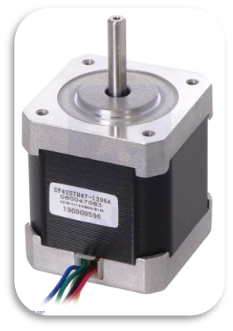
VOICE SENSOR FOR ELECTRONIC GADGETS
STEPPER MOTOR
This motor divides a full rotation into a number of equal steps
It operates on the mechanism where the permanent magnet in the rotor works with stator electromagnets according to their attraction and repulsion

Slide 12
VOICE SENSOR FOR ELECTRONIC GADGETS
SOLUTIONS WITH THE PROTOTYPE AND WHY?:

Slide 13
VOICE SENSOR FOR ELECTRONIC GADGETS
SOLUTIONS WITH THE PROTOTYPE

Slide 14

VOICE SENSOR FOR ELECTRONIC GADGETS
Lock

Slide 15
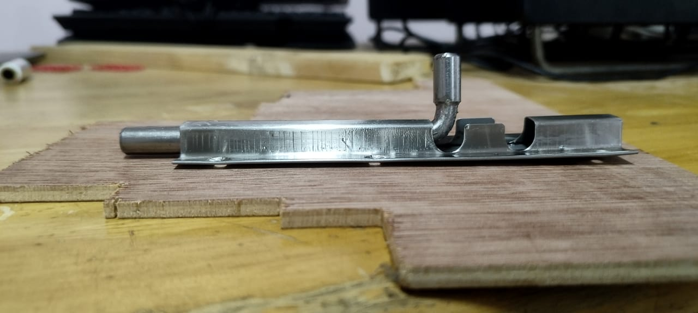
VOICE SENSOR FOR ELECTRONIC GADGETS
Lock

Slide 16

VOICE SENSOR FOR ELECTRONIC GADGETS
Lock
Unlock

Slide 17
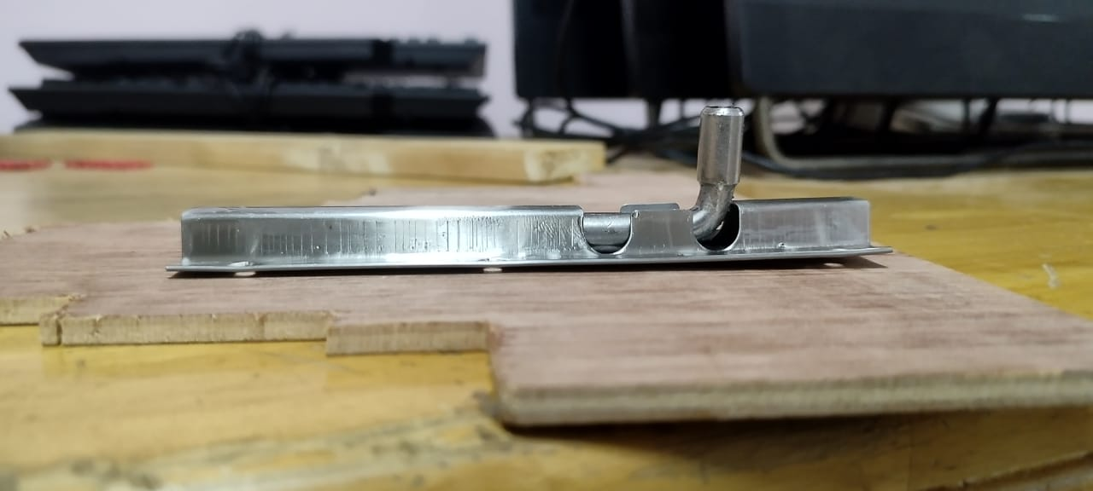
VOICE SENSOR FOR ELECTRONIC GADGETS
Lock
Unlock

Slide 18
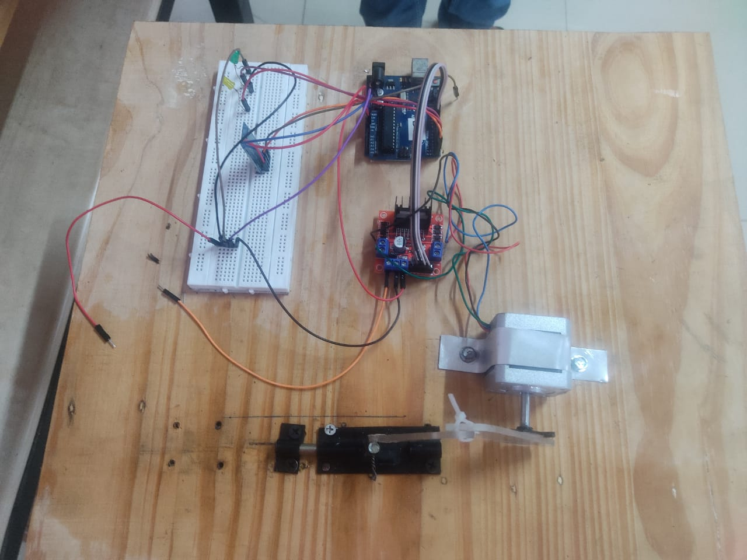
VOICE SENSOR FOR ELECTRONIC GADGETS

Slide 19
VOICE SENSOR FOR ELECTRONIC GADGETS
SOLUTIONS WITH THE PROTOTYPE AND WHY?

Slide 20
VOICE SENSOR FOR ELECTRONIC GADGETS
Circuit Diagram and Connections

Slide 21
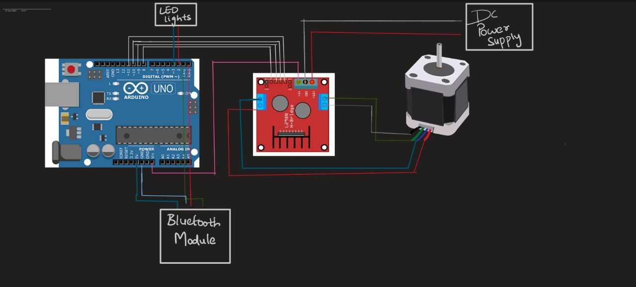

Slide 22
VOICE SENSOR FOR ELECTRONIC GADGETS
Mechanism that converts rotatory motion to translatory motion

Slide 23
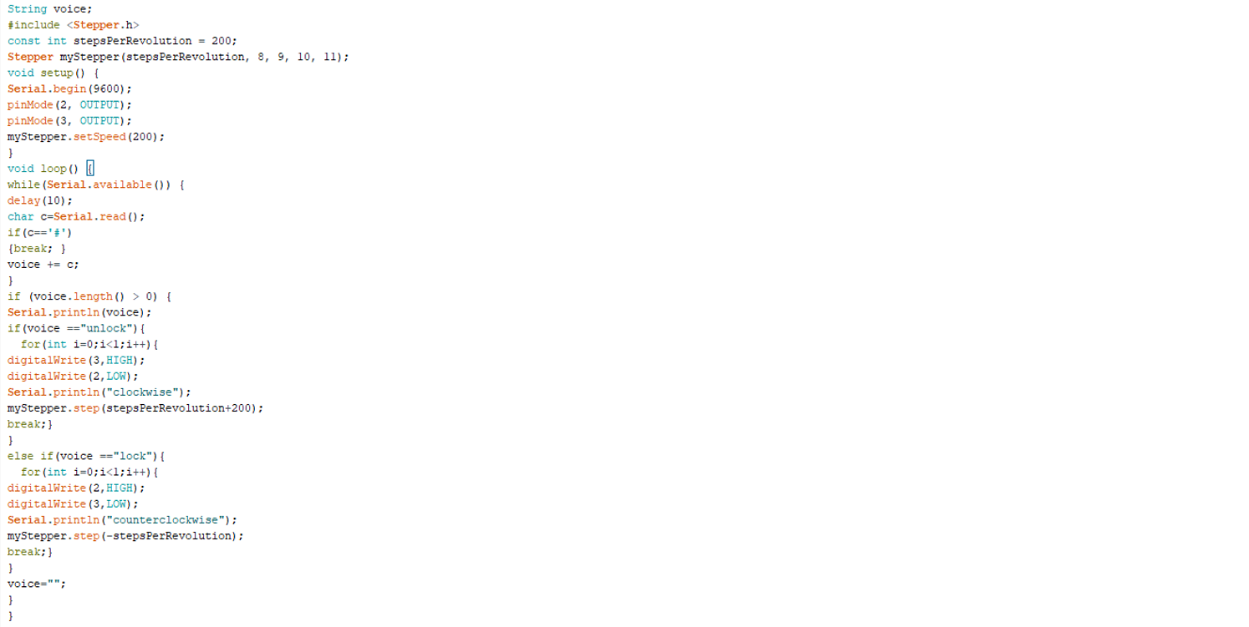
VOICE SENSOR FOR ELECTRONIC GADGETS
THE CODE:

Slide 24
VOICE SENSOR FOR ELECTRONIC GADGETS
VERIFY THE SOLUTION ( TESTING):

Slide 25
